Slide 1
CSP1150/CSP5110: Programming Principles
Lecture 1: Introduction to Programming

Slide 2
This Lecture
Establishing a context
Approach to the unit
What is programming?
Program implementation and source code
Program design
Pseudocode and flowcharts
A brief history of programming languages
Getting started
Introduction to Python
A simple program
Variables, comments and concatenation

Slide 3

Textbook
Starting Out with Python, 3rd Edition
Tony Gaddis
Reading the chapter(s) is required
Read the indicated chapter(s) before class
This week covers the following textbook chapter(s):
Chapter 1 – Introduction to Computers and Programming
Entire chapter
Chapter 2 – Input, Processing, and Output
Entire chapter
Appendix A and B

Slide 4
Establishing a Context

Slide 5
Approach to the Unit
This unit aims to teach you introductory programming
It does not aim to teach you “programming in Python”
The language you happen to use when learning to program is not the focus or goal, it is simply the tool you are using
When you learn to drive, you learn to drive a car – not a dark red 1997 Ford Festiva Trio
We will focus on the core concepts of programming
What they entail
Why they are necessary, important or desirable
How (and why) their implementations differ between languages
Most of the examples, and your lab work, will just happen to use the Python programming language
Notes:
To add to the car analogy – there may indeed be a significant distinctions between cars that limit how transferrable your skills are, e.g. manual vs. automatic. However, most of the concepts that you know are still relevant and useful if you change between manual and automatic cars. You may need to learn a few new things, but you are certainly not learning a new skill from scratch. This holds true in programming – if you’ve learned procedural programming and find yourself needing to do object oriented programming, you will need to learn a few new things, but the majority of your programming knowledge and skill will still be useful and relevant.

Slide 6
Approach to the Unit
While Python is the programming language we focus on, this unit will discuss and demonstrate other languages
This is to keep you focused upon the concepts being covered, rather than their specific implementation in Python
Code samples written in Python will look like this:
Code samples written in other languages will look like this:
# print "Hello world!" to the screen
print('Hello world!')
Python
// print "Hello world!" to the screen
class HelloWorld
{
public static void main(String[] args)
{
System.out.println("Hello world!");
}
}
Java
Notes:
As you can tell, one of the reasons we are using Python rather than Java is that it is much more concise and elegant, particularly when it comes to simple examples.
The text in green is a comment – it doesn’t do anything as far as code is concerned, it is just there to provide information to people who are looking at the code.

Slide 7
What is Programming?
Let us first consider “What is a computer?”
A computer is a device with a few basic components:
A processor (CPU) which can execute basic instructions
Memory to store data and instructions that are in use
Storage for ongoing retention of data and programs
Input and output devices to communicate/interact with users
Computers exist to be useful; To do things for us
e.g. Automation of a manual process, or making something possible that would otherwise be impossible or unfeasible
Computers need to be told exactly how to do things
This must be written in a way that a computer can understand i.e. they must follow a pre-defined set of rules
Notes:
This architecture of a computer is known as the von Neumann architecture, and describes the vast majority of today’s computers. Whenever a computer is running, it is performing what is known as the “fetch-execute cycle” (sometimes referred to as the “fetch-decode-execute cycle”). The processor is constantly retrieving the next instruction, processing it, then moving on to the next one.
The computer’s memory (RAM) holds the data and programs that are in use, feeding them to the CPU when requested.
RAM is volatile – i.e. its contents are overwritten as needed and erased when the computer turns off. Hence, computer’s storage (typically in the form of hard drives, optical media such as CDs and DVDs, thumb drives, etc) allows data and programs to be stored on an ongoing basis.
Input devices are typically a keyboard and mouse, however different types of computers have different input devices – microphones, touch screens, scanners, etc. Output devices include the monitor, speakers, printers, etc.
Another commonly listed component of a computer is communication devices – components which allow the computer to communicate with other devices/computers, e.g. over a network or wirelessly. They are an underlying necessity in a modern computer (and something we will assume the existence of), but not something we need to delve into at this point. They can be thought of as input and output devices, however instead of communicating and interacting with users, they are communicating and interacting with other devices/computers.

Slide 8
Operating Systems
Operating systems such as Windows, Mac OS or Linux sit between the hardware and the programs on a computer
Operating Systems are responsible for:
Interfacing with the hardware of a computer and making it available for programs to interact with
Managing the storage and organisation of data and programs
Allocating and scheduling the usage of the computer’s processor, memory, etc, so that everything can run smoothly
Managing users and security
This provides a layer of abstraction, so that programs can interact with hardware and resources in a consistent way
Hence programming languages / programmers do not need to implement things “from the ground up” every time
Notes:
You will learn a lot more about this topic in the Operating Systems unit. This slide simply summarises the key functions of an operating system and the role that it plays with regards to programs.

Slide 9
Data Storage & Binary
All data in a computer’s memory is stored in small storage locations named “bytes”, which consist of 8 “bits”
A bit can contain either 0 or 1 (binary)
There are 256 possible combinations of bits in a byte:
00000000, 00000001, 00000010, 00000011, 00000100...
You can read numbers in binary using powers of 2, right to left
e.g.
Storing letters characters (e.g. letters) involves mapping them to a numeric code (e.g. A = 65), which is stored in binary
ASCII and Unicode are the two main coding schemes in use
1 | 0 | 1 | 1 | 0 | 0 | 1 | 1
2⁷ | 2⁶ | 2⁵ | 2⁴ | 2³ | 2² | 2¹ | 2⁰
128 | 64 | 32 | 16 | 8 | 4 | 2 | 1
128
+
32
+
16
+
2
+
1
= 179
Notes:
Note: This slide is hidden as it covers a topic not relevant or necessary enough to cover in an already quite long lecture. The textbook covers it, and you are welcome to go through the slide, but the concept will be covered more thoroughly in other units such as ENS1161.
As far as the hardware of a computer is concerned, a bit is essentially storing either a positive or negative electrical charge.
“Normal” counting using the numbers we all know is “base 10” or “decimal” – there are 10 different digits (0 to 9).
When we count, we add another digit whenever we run out of digits, e.g. 0, 1, 2, 3, 4, 5, 6, 7, 8, 9… and now that we have run out of digits, we add a second digit and start from the beginning again: 10, 11, 12, 13, etc.
Two digits will take us all the way to 99, at which point we’ve used all combinations of two digits so we add a third one… 100, 101, 102, 103, and so on.
This is exactly how binary works – binary is just counting in base 2 – i.e. two digits only (0 and 1).
We count through the digits we have… 0, 1… Then we add another digit and start again: 10, 11. Add another digit, start again, 100, 101, 110, 111…
As a programmer, this is not something that you’ll really need to know or do very often – it’s background information that helps you to better understand how computers work.

Slide 10
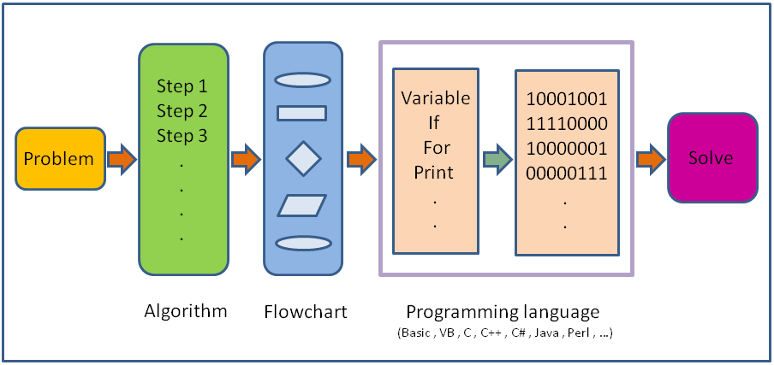
What is Programming?
So, what is programming? Programming is problem solving
Programs are written in order to fulfil a need / solve a problem
A programming language is the tool used to create a solution
By writing a program using a programming language, you can make a computer do something useful
Notes:
Image from Wikiversity.org, CC BY-SA 3.0.
The image may be a little bit misleading in that it suggest that flowcharts follow on from algorithms (in the form of pseudocode). As we’ll cover later this lecture, they are both just ways of designing a program and representing the steps that it will go through to solve a problem. You can use one without the other.

Slide 11
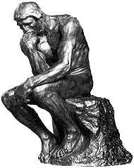
Why Learn Programming?
Learning to program is about developing cognitive processes - i.e. ways of thinking - not memorising syntax
Programming teaches you to think about a problem and design a solution that adheres to an established set of rules
Programming teaches you to think in a precise and methodical manner when approaching a problem
Programming teaches you to think of solutions that are appropriate, elegant, modular and well-structured
Programming teaches you to think
Notes:
I imagine many of the people who take this unit do not particularly want to learn programming. They don’t plan to become a programmer, or they think it’s too hard, or they just don’t think it’s relevant to their career goals… I believe that everyone can and should learn to program – at least a little bit.
If all you come away with at the end of this unit is “a handful of basic Python knowledge”, then you’ve missed the point. This unit is about developing the cognitive processes needed to think about problems and come up with solutions which adhere to the established conventions of programming. It’s something that, once you internalise, you can apply to all problems to some degree.

Slide 12
Program Implementation
A computer’s processor can only understand a set of very basic instructions, such as simple arithmetic operations
This is known as machine code, and it is not feasible to write long or complex code directly in machine code
To make this easier, assembly language was developed
Assembly language replaces the numeric instruction codes of machine code with short descriptive words, e.g. “add”
Each instruction corresponds to a machine code instruction, so it is still very low level and unfeasible for complex code
B801000000
BF02000000
01F8
Machine Code
mov eax, 0x1
mov edi, 0x2
add eax, edi
Assembly
Notes:
These lines of machine code (and the equivalent assembly code) move two values (1 and 2) into registers in the CPU, then add the numbers together.
Assembly language still needs to be translated into machine code in order to be executed by the processor.
You will learn more about these topics in Computer Fundamentals.

Slide 13
Program Implementation
In order to write complex programs in a way that is easy to read and write as well as being processor-independent, we use high-level languages
These are the programming languages you hear about / use: Python, C, Java, PHP, C++, JavaScript, etc
Instructions in high-level languages are “statements”, and usually translate to multiple machine code instructions
These languages are much easier for people to write code in, as well as reading and editing that code at a later stage
The code of a program written in a high-level language is known as the “source code” of the program
The computer’s processor still only understands machine code; the source code must be translated into machine code
Notes:
Simple statements in a high-level language, such as a statement that adds two numbers and stores the result, may translate to a single machine code instruction.
However, high-level languages allow for much more sophisticated statements – anything from opening a new window to saving data to a file or generating an image or 3D graphics… These statements are likely to translate into hundreds if not thousands of machine code instructions.

Slide 14
Program Implementation
There are two main approaches for translating high-level source code into machine code:
Compilation: The entirety of the source code is translated into machine code and an executable file of it is produced
This is a relatively slow process, however the resulting file runs quickly as it is not being translated on the spot, and the compiler can spend time to further optimise the resulting file
Some compiled languages include C and C++
Interpretation: An interpreter translates and executes each source code statement one at a time as the program is run
Slower to run as it is “doing it live”, but fewer steps involved
Some interpreted languages include Python, PHP and JavaScript
Some languages, e.g. Java & .NET languages, use a hybrid method – compiling to “bytecode” and interpreting that
Notes:
Interpreted languages are often considered to be more “accessible” than compiled languages, as there is no need to compile your code before running it. This makes it very convenient to make minor changes to your code and see their effects without the delay of compiling the code before running it.
Bytecode is essentially a semi-compiled form of code that can be interpreted faster than pure source code. Sometimes bytecode is interpreted, and sometimes a process known as “Just In Time” (JIT) compilation is used – where the bytecode is compiled into machine code as needed when the program is run. Either approach essentially aims to merge the convenience and portability of interpreted languages with the speed and optimisation of compiled languages.

Slide 15
Source Code
A program’s source code consists of a list of statements written in a programming language
Every statement must adhere to the syntax of the language
The “words” that the language recognises
The “phrasing” required to specify values
The ways of arranging these into valid “sentences”
Any errors in your syntax will prevent the code from running
Do not fear error messages; read them and learn from them
prunt('Hello world!')
Traceback (most recent call last):
File "C:\Python\Scripts\test.py", line 1, in <module>
prunt('Hello world!')
NameError: name 'prunt' is not defined
Python
Error location
Erroneous statement
Type of error
Notes:
Remember that a computer cannot “think” – it can only follow the rules that it has been given. So when it comes to understanding your code, you must type it in the way that has been defined as valid, otherwise it will not be understood.
It’s easy to compare programming languages to natural languages such as English when it comes to concepts such as syntax.
If I say “sdsefdr”, you won’t know what I am trying to communicate because it is not a recognised word.
If I ask you how old you are and you respond with “scissors”, I won’t know what I am trying to communicate because I was expecting you to respond with a number.
If I say “Potato do cat left lock with seven”, you won’t know what I am trying to communicate because even though I am using recognised words, I have not arranged them into a valid sentence structure.
Trying to code with a New Zealand accent will not work.

Slide 16
Source Code
When program is run, it runs the statements in the source code from start to end (unless it encounters an error)
Some statements choose between different sections of code to run based upon the result of a conditional check (Selection)
Some statements repeatedly run a section of code until a certain condition is met (Iteration)
Some statements request input from users or data from other sources, often processing it using selection and iteration
Some statements define sections of code to be used at other points in the program where it is needed (Functions)
Many programs are “event-driven”, meaning that they wait for events to occur (e.g. the user clicking on something)
When an event occurs, it triggers some statements to be run
Notes:
We will be covering all of these types of statements in upcoming weeks – they represent some of the core concepts of programming.

Slide 17
Walking Exercise
Goal: To navigate from one end of the room to the other
As an English-speaking human, this can be achieved simply by telling the person “Go over there”… Easy!
We will be instructing a robot (played by a volunteer), who can only understand the following statements:
FORWARD( num )
Walk forward num steps (assume 1 metre steps)
TURN( LEFT | RIGHT )
Turn 90 degrees left or right
The robot must be given all of their statements in advance
Bonus points for walking like a robot or making robot noises
Notes:
This exercise illustrates solving a problem within the boundaries of an established set of rules.

Slide 18
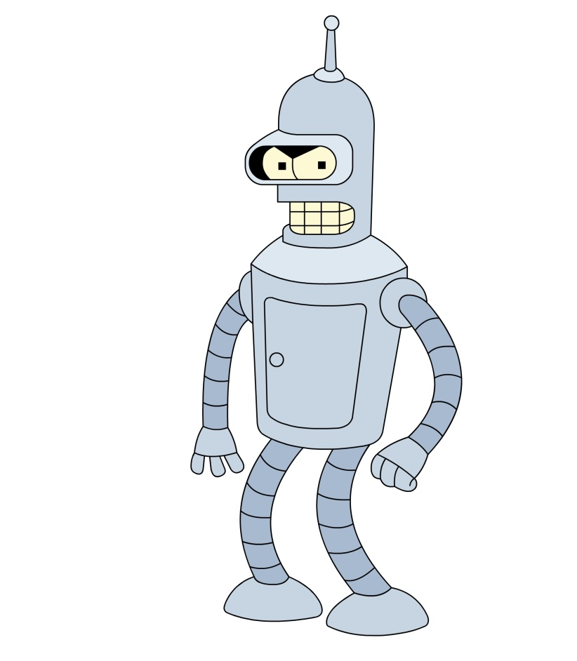
Walking Exercise
RoboTest.robo
EndOfRoom.robo
FORWARD(1)
TURN(LEFT)
FORWARD(1)
TURN(LEFT)
FORWARD(1)
TURN(LEFT)
FORWARD(1)
TURN(LEFT)
Robo
Robo
Notes:
First we’ll test our robot by making him execute the RoboTest.robo program (note that Robo is not a real programming language, and RoboTest.robo is not an actual file).
Next, let’s write the program to navigate our robot to the other side of the room.

Slide 19
Program Design

Slide 20
Program Design
Writing syntactically correct code is difficult and can distract you from the problem that you are trying to solve
Hence it is useful to be able to plan out the logic and structure of your solution prior to commencing the actual programming
This is the concept of program design
Pseudocode and flowcharts are two ways of representing the steps and statements that a program will implement
Pseudocode and flowcharts…
are valuable design tools that experienced programmers use
are designed to be read by people, not parsed by a computer
follow conventions of programming, e.g. selection & iteration
often omit minor, insignificant and assumed statements
Notes:
Pseudocode and flowcharts are some of THE best tools you can use to learn to design and implement programs well. They force you to think about what you are doing and aiming to achieve, rather than focusing upon the syntax of the language you happen to be using. They also force you to think in the style and conventions of programming – a sequence of statements, utilising selection and iteration, etc.
While an experienced programmer won’t write pseudocode or draw flowcharts for every single thing they program, they will often jot some things down to represent the overall structure of the program and any particularly tricky sections.

Slide 21
Program Design
Pseudocode does not have defined standards, rules or syntax that need to be adhered to
There is no single “correct” way to write pseudocode
To emphasise this, different conventions have been used in each of the following pseudocode examples
Flowcharts are a more visual approach to program design, using symbols with specific meanings associated with them
They are “stricter” than pseudocode, but this is a necessity in order to produce flowcharts that anyone can read
Always remember that the goal of these design tools is to illustrate and communicate your design in a clear way

Slide 22
Flowchart Symbols
This table summarises the main symbols used in flowcharts
Note that flowcharts are used to illustrate algorithms to solve problems in many fields, not just programming – very useful!
Symbol | Meaning
 | Flow Line (indicates direction and connection between things)
 | Processing (indicates a basic operation, step or action)
 | Terminator (indicates start or end of a flowchart)
 | Input/Output (indicates input or output)
 | Decision (indicates a choice with true/false outcomes)
 | Predefined Process/Function (indicates a group of statements that perform a task – may be detailed in separate flowchart)
Notes:
The concept of flowcharts is a generic one that happens to work well for programming. We are not learning something programming-specific here – we are learning a simple, visual way of representing the solution to a problem – i.e. the steps of an algorithm.
Also note that there are more symbols than this for flowcharts, however they are not as widely known as the basic ones here. If you want to be sure that your flowchart communicates clearly, try to stick to the basic symbols – the whole point of something visual like a flowchart is that people can take it in quickly and simply… If they need to look up some obscure symbol, you lose that benefit. Instead, consider using a simpler symbol with the text inside it describing things as needed.

Slide 23
Pseudocode and Flowchart Examples
Let’s look at some examples of pseudocode, flowcharts, and corresponding source code
Get value
Prompt the user for a value
Multiply the value by 2
Show the value on the screen
Pseudocode
Result = value * 2
Display result
value = input('Enter a value: ')
result = int(value) * 2
print(result)
Python
Notes:
Some people prefer to write pseudocode that is closer to the actual code than others. Some people prefer to write things in a more natural English way.
Neither approach is wrong, as long as it can represent the structure of the code in a useful and meaningful way.
You may notice that I haven’t bothered to include the terminator symbols at the start and end of this flowchart? Why? Because I didn’t feel that they would add anything of value to the diagram. Always remember that the purpose of such diagrams is to communicate something clearly. The conventions are flexible – if something is not needed or would be confusing, there’s no need to include it.

Slide 24
Pseudocode and Flowchart Examples
IF length of name > 15 THEN
PRINT name length error message
ELSE
PRINT name saved message
Pseudocode
Name length > 15?
True
False
Display name length error
Display name saved message
if (name.length() > 15)
{
System.out.println("Error: Name too long.");
}
else
{
System.out.println("Your name has been saved.");
}
Java
Notes:
Note that this is a snippet of a program, not an entire program. It assumes that a “name” variable exists before the start of the snippet, and that something is done to save it afterwards, etc…
In this example, we’ve used uppercase keywords to emphasise the structure of the code.
The fact that this is a snippet of code also means that the flowchart is not complete – it is illustrating what would be part of a larger program.

Slide 25
Pseudocode and Flowchart Examples
Get user details from database
get user details from database
while (rows remaining in result set)
{
get next row of data
print name from row
}
Pseudocode
Row remaining?
True
False
Get next row of results
Display name from row
$results = $db->query("SELECT * FROM users");
while ($row = $results->fetch_assoc())
{
echo $row['first_name'];
}
PHP
Notes:
Again, this is a snippet of code – it assumes the existence of a database server, a connection to that server, a table named users, columns in that table named first_name and last_name, etc.
This time we’ve included the parentheses and braces that many programming languages use to delimit sections of code.
Again, since it’s a snippet of code the flowchart is also incomplete… The False line would flow to the next part of the program, i.e. what happens after the last row has been retrieved and the name displayed. Flowchart diagrams also include a special symbol for databases (as well as one for files, memory, etc), but I’ve chosen not to use it in this flowchart. Why? Again – clarity of communication.
You may notice that the actual PHP code doesn’t quite match the structure of the design in one small way – the test for whether or not there is a row remaining has and the statement to retrieve the next row have been combined into one. This is the most elegant and common way of doing this in PHP, so I felt it was worthwhile showing it in that way – and it also emphasises the difference between design and implementation.

Slide 26
Software Engineering & Program Design
Software Engineering describes the process of designing, developing, testing and maintaining a piece of software
Numerous different approaches to this are possible
There are numerous other tools and techniques that are involved in the design (and development) of software
Some are only relevant in certain types/scales of software
Some design tools and techniques in this process include…
Program specifications (documenting the scope/functionality)
User interface design (mock-ups of visual elements)
Software architecture design (high-level logistics of software)
You should know exactly what you are building, and how, before you start writing any code
Notes:
This is particularly important since software aims to solve a problem or fulfil some kind of need. If you just start writing code without thoroughly examining the problem and designing an appropriate solution it is very likely that you will either end up with a program that doesn’t quite solve the problem, or that you write code that will need to be rewritten to make it do what is needed.
Both of these outcomes are expensive and time-consuming, and hence should be avoided.

Slide 27
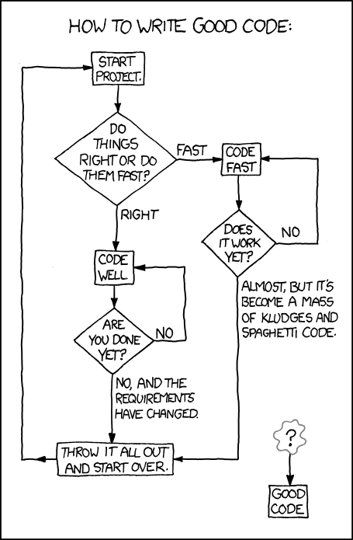
Writing Good Code…
xkcd.com
Notes:
A cynical but amusing look at the concept of writing good code.
Plus it uses flowcharts!
Comic (c) xkcd - http://xkcd.com/844/

Slide 28
A Brief History of Programming Languages

Slide 29
Early High-Level Languages
Fortran is generally credited as the first high-level language
Originally released in 1957, with subsequent versions released since then (it’s still being released and used)
Introduced many of the core concepts and conventions of programming that we now take for granted
Designed for scientific applications
In the 1960s, computers were beginning to see significant usage in business, which had different needs than science
COBOL was a language designed to meet these needs, aiming for accessibility and English-like syntax
While not much COBOL is being written these days, many businesses are still running COBOL code in various systems
Notes:
“Science” was the original domain that computers were applied to, followed by “Business”.

Slide 30
Programming Languages, 1960s – 1980s
Many other significant languages released over the years:
BASIC (1963) emerged as a teaching language, and lives on as Visual Basic .NET these days
PL/I (1964) tried to take the best aspects of all languages and invented some new ones in an attempt to be able to do it all
Pascal (1971) also designed for teaching, led to Turbo Pascal
C (1972) was designed for systems programming (e.g. OSs) was very expressive and powerful – also packaged in UNIX
Ada (1974) developed for US DoD to standardise the software used in embedded systems. Introduced some new concepts
Smalltalk-80 (1980) was first fully Object Oriented language, expanding on features that appeared in SIMULA and Ada
C++ (1983) evolved from C, incorporating OO from Smalltalk
Notes:
Most languages were influenced by or derived from previous languages, and the significant ones went on to influence future languages… Many of these languages only became popular in later versions, released years after the initial release year that I’ve indicated.

Slide 31
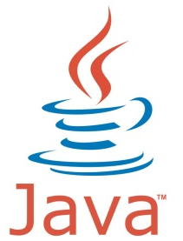


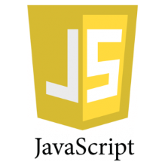

Programming Languages, 1990s and Beyond
Some of the more modern languages include…
Python (1991), general purpose language emphasising readability and expressiveness. Supports OO and other styles
Java (1995), OO, designed to be platform independent
PHP (1995), designed for web development (server-side)
JavaScript (1995), designed for web development (client-side)
.NET (2002) is a framework allowing for interoperability between many different languages (C#, VB.NET, ASP.NET…)
And more (including some popular and/or significant ones)!
This isn’t a topic worth examining in further detail at this point
Notes:
It’s worth noting that Python only really started to pick up steam and popularity when version 2 was released, in 2000.
In this unit we use version 3, the first release of which was in late 2008.

Slide 32
Programming Language Design Focus
In the 1950s and 1960s languages focused upon writability
How easy and effective it is to write code in the language
Why? Few people writing code, not much reuse or maintenance, time-consuming and costly to write and run
By the 1970s, languages started emphasising readability
How easy it is to read code in the language
Why? More people (not just scientists) coding, larger and more complex code in use, lots of maintenance and updating
Striking a balance between these is important in a language
Other factors include reliability (particularly for mission critical code) and cost (influenced by all other factors – time and effort needed to learn, train, write, read, maintain, etc.)
Notes:
High writability often comes at the expense of high readability, and vice versa. e.g. a very concise piece of code can be quicker to write, but harder to read.
Highly writable languages are quicker and easier to code in, minimising the cost of developing code.
Highly readable languages are quicker and easier to maintain, minimising the cost of maintaining/updating code.
Highly reliable languages do not need to be maintained as often, minimising the cost of maintaining/updating code - The failure of a mission-critical program could be very costly.
The intended usage of a language will influence its design and which of these factors it emphasises. For example, Ada was designed for use in embedded systems for the US Department of Defence. Since Ada code was likely to be embedded in mission critical systems, reliability was a major focus in the design of the language. Most of the new ideas that Ada introduced to the programming world relate back to reliability.

Slide 33

Introduction to Python
Notes:
Ni!

Slide 34

Introduction to Python
Python is a general purpose scripting language released in 1991 by Guido van Rossum
Started gaining popularity in 2000 when Python 2.0 was released, becoming a community-driven project
Although development of the language is now open-source, Guido is the “benevolent dictator for life” (has final say)
Python 3.0 was released in late 2000, dubbed “Python 3000” and “Py3K” by some, and had a big focus upon cleaning up some of the redundant and inconsistent parts of the language
The changes made it impossible for versions 2 and 3 to be fully compatible, so they were developed side-by-side until 2011
Development now focused upon version 3, which is the recommended version for modern usage and education
Notes:
The term “benevolent dictator for life” is not just a joke – it’s a title given to people (typically the founder) who have the final say in otherwise community-driven or open-source software projects.
The title originated when it was given to Guido in regards to Python.
If you’re wondering what the language has to do with snakes… Python was named after the comedy group Monty Python; References to them can be found all over the documentation.

Slide 35

The Philosophy of Python
Python was designed to be elegant, simple and readable, allowing programmers to write clear and concise code
These features make it a good language to learn programming
Tim Peters, a long time “Pythoneer” summarised the guiding principles behind Python in “the Zen of Python”. It includes:
Beautiful is better than ugly
Simple is better than complex
Complex is better than complicated
Readability counts
Special cases aren't special enough to break the rules
Although practicality beats purity
There should be one – and preferably only one – obvious way to do it
Notes:
I’ve left out a number of the aphorisms (lines) in the Zen of Python, so that I can fit them on the slide and focus upon the most significant and meaningful ones. If you want to see the whole lot, either google for “the Zen of Python”, or just run the statement “import this” in Python.
The changes made between Python 2 and 3 really emphasised the last of the lines I quoted – ensuring that there were not multiple redundant ways to do things, improving the consistency of the language, etc.

Slide 36
Features and Design of Python
Python supports many different “styles” (paradigms) of programming; Object-Oriented, procedural, functional…
Python is interpreted, available and compatible on most platforms, and can do many useful things “out of the box”
Python is known for using whitespace to delimit code blocks, rather than braces (“{ }”) or keywords (e.g. “endif”)
This helps code remain readable, since it eliminates ambiguity (particularly when there are blocks within blocks within blocks)
if status == 'complete':
print('All done!')
saveResults()
Python
if (status == 'complete')
cout << 'All done!';
saveResults();
if (status == 'complete'){
cout << 'All done!';
saveResults();
}
if (status == 'complete'){
cout << 'All done!';
saveResults();
}
if (status == 'complete')
{
cout << 'All done!';
saveResults();
}
if (status == "complete")
{
cout << "All done!";
saveResults();
}
C++
C++
C++
C++
C++
!
Notes:
I’m very much glossing over most of the features of Python and what makes it different from other languages, since at this stage the information is likely to mean very little to you and won’t particularly be helpful in learning the language.
Note that the final C++ example (view the slideshow to see them all) is functionally different from the others – if you omit the braces in most languages, only the single next statement will be considered part of the block. The indentation in the final example implies that both statements should be run depending on the “if” statement, but only the first one will – the second statement will run all the time regardless.

Slide 37
Our Programming Environment
Obtaining Python is as simple as downloading it from python.org and installing it like any other program
The quickest and easiest way to get started is to run IDLE, the integrated development environment (IDE) for Python
This opens a “Python shell” window, indicated by a “>>>”, where you can type Python code and it will be run immediately
The Python shell is useful for quickly trying and testing bits of code, but most of the time you will want to create a file
Press Ctrl+N or go to “File > New File” to create a new file (of course, you can also open existing Python code files)
This opens a “Python editor” window which you can type code into, before saving (Ctrl+S) and running (F5) the code
Output from the code and prompts for input appear in the shell
Notes:
IDLE is Python’s Interactive DeveLopment Environment. As you can see, referencing the name of a Monty Python member is more important here than coming up with a proper acronym.
Appendix A and B of the textbook go over how to install Python and introduce you to the IDLE environment.

Slide 38
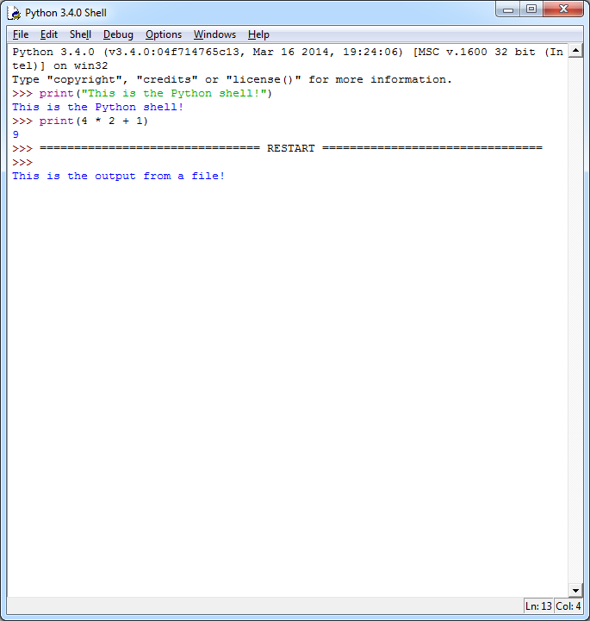
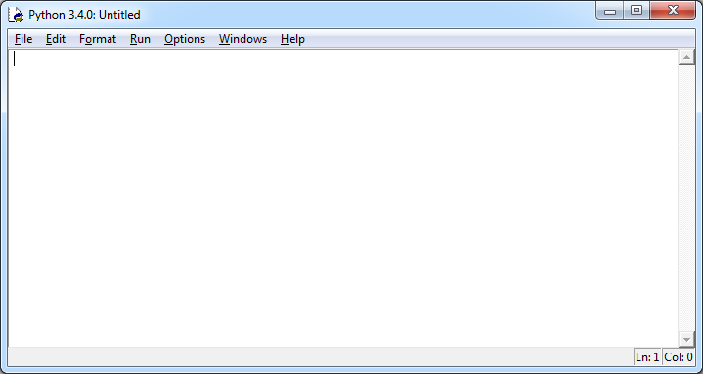
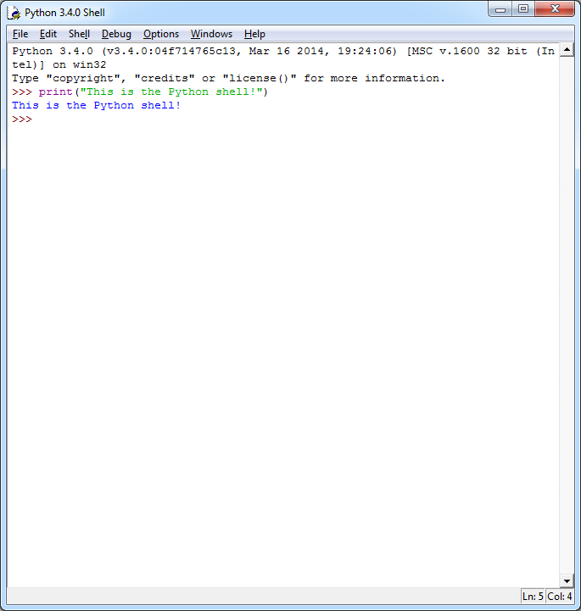
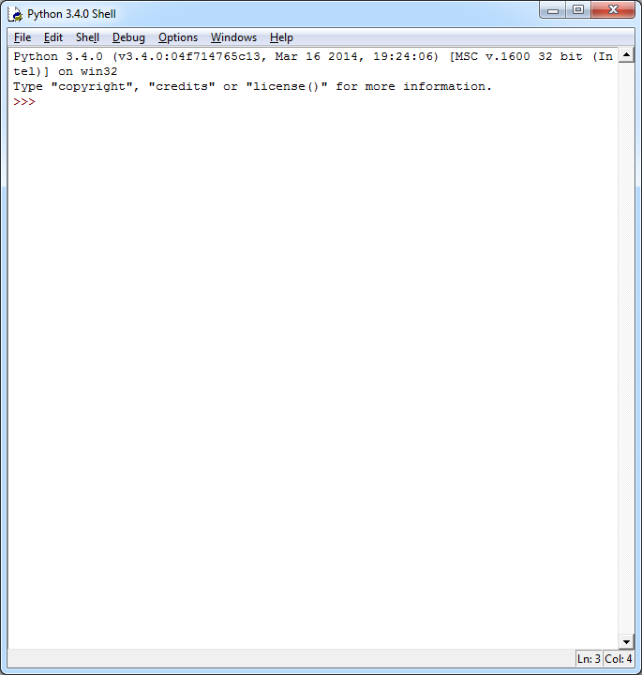
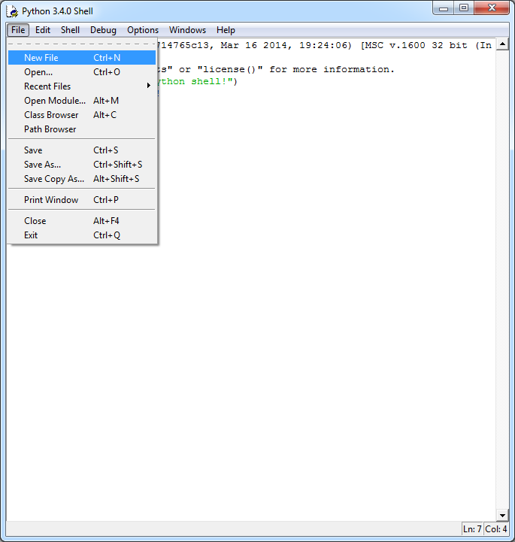
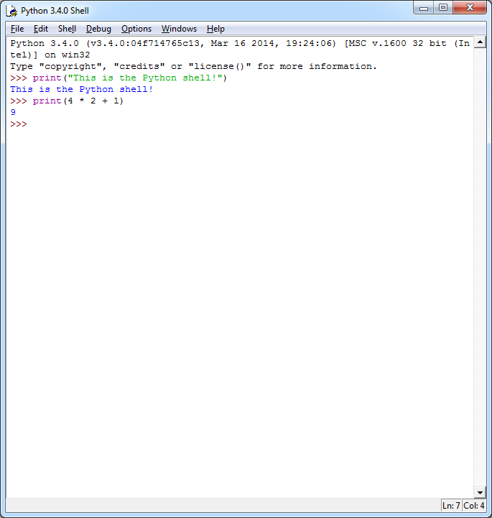
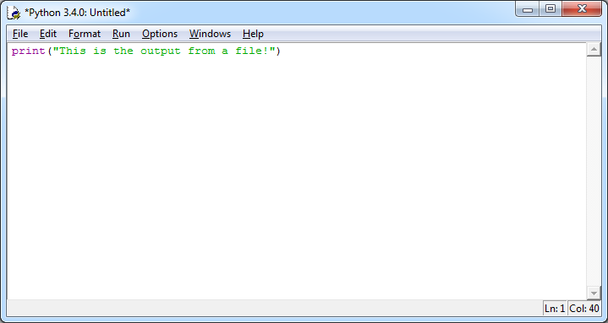
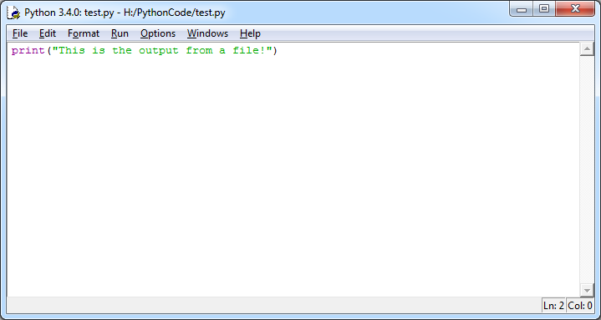

Our Programming Environment
Python Shell
Type code to run it now
Input and output of files
Python Editor
Type code into file
Save file with Ctrl+S
Run code with F5
You can right click a Python file to “Edit with IDLE”
Run the file
(F5)
Save the file
(Ctrl+S)
Notes:
Note: The exact version number of Python that is installed appears in the window title and in some other places… Do not worry if the version you are using is exactly the same as the one in these screenshots. It is not worth redoing the screenshots every time a minor update is released.
Typing a command into the Python shell and pressing enter will run it immediately – it’s like writing a program where each line is run as you type it.
The Python editor is essentially like using a version of Notepad that has some extra features to make it convenient to type code into.

Slide 39
A Simple Program
Let’s look at a simple program to convert pounds to kilos:
Each line in the program is a statement; a single step:
Prompt the user for a value and save it as “value”
Multiply “value” by 0.454, and save the result as “result”
Display the result
Python does not require a “;” after each statement
Many languages do require this – see slide notes for why!
Prompt the user for a value in pounds
Multiply the value by 0.454
Show the result on the screen
Pseudocode
Get value
Result = value * 0.454
Python
# convert pounds to kilograms
value = input('Enter a value in pounds: ')
result = float(value) * 0.454
print(value, 'pounds is', result, 'kilograms')
Display result
Notes:
Python does not require a semi-colon at the end of a statement, but many other languages do. The main reason for this goes back to Python’s design goals and philosophy – particularly the ones regarding readability. Python values (and when it comes to indenting, enforces) whitespace in source code, since it makes the code more readable.
The main reason for requiring a semi-colon at the end of a statement in most languages is that it allows you to write multiple statements on a single line. This comes from the perspective that since interpreters and compilers ignore whitespace, it shouldn’t matter in the code either. While this may allow you to write programs which look slightly more concise, it can easily lower the readability of your code.
This is an example of a language’s design goals influencing how things are implemented.

Slide 40
Variables
This program introduces the concept of variables
A variable allows you to associate a value with a name
The variable name can then be used in future statements to refer to the value that it contains (which is stored in memory)
This is useful, since programs need to use values that are not known in advance (e.g. the result of input or a calculation)
In most circumstances, you can overwrite the value that a variable contains simply by assigning a new value to it
example = 2
print(example)
2
example = 'Now it contains a string!'
print(example)
Now it contains a string!
Python
Notes:
Variables allow your program to say “remember this value; I want to use it later”.
Assigning a value to a variable allows you to associate it with a name, so that you can refer to it without knowing the exact value.
Many languages have “constants”, which are variables that you cannot change the value of. You create it, define it’s value, and that’s it.
These are useful if you want to refer to a value in multiple places in a program (e.g. if it is used in various calculations). Instead of having to type the value itself, you can just type the name of the constant. Then, if you need to change the value you only need to change it in one location – the place where you define the constant. This is not only less work to maintain, but it makes it impossible to end up with inconsistent values since you don’t need to remember to change every instance of it in a program.

Slide 41
Variables
We have seen examples of assigning a value to a variable
<variable name> = <value to assign>
example = 'This is an example!'
There is likely to be calculation or input resulting in the value…
value = input('Enter a value in pounds: ')
result = float(value) * 0.454
We have also seen examples of variables being used
Simply refer to the name of the variable where it is needed
print(value, 'pounds is', result, 'kilograms')
The type of value that the variable contains may need to be taken into account – e.g. converting a string to a float
Notes:
In almost every language, a single equals sign is used to assign a value to a variable (as shown in the slide). A double equals sign, ==, is used to compare two values for equality. e.g. 5 == 5 is true, and 5 == 6 is false.
The last point on the slide is an important one to keep in mind, and something you are likely to forget early on. The example stated relates to how the input() function (described in more detail later) works: It prompts the user to type something in then press enter. No matter what is typed in, the value is considered to be a string – a sequence of characters. We have asked the user to type in a number, but this will still be stored as a string – e.g. a series of characters consisting of “25” as opposed to the number 25. Hence, before we can use the value in mathematical calculations, we need to convert it to a number – which is what the float() function does.
In a more complete example, we would include code to check/ensure that the user did indeed type an appropriate number and provide an error message otherwise.

Slide 42
Variable Assignment Shortcuts
Most languages (including Python) offer shorter ways of assigning a values to variables that involve basic maths
The number 5 in these examples is completely arbitrary
Assume that x contains a number and y contains a string (text)
Most languages also provide a way to add or subtract 1:
x++ and x--
Python doesn’t allow this, since x += 1 and x -= 1 are just as good. Remember “there should be one obvious way to do it”
Shortcut | Longer Equivalent | Definition
x += 5 y += 'dog' | x = x + 5 y = y + 'dog' | Add 5 to x Add "dog" to the end of y
x -= 5 | x = x - 5 | Subtract 5 from x
x *= 5 | x = x * 5 | Multiply x by 5
x /= 5 | x = x / 5 | Divide x by 5
Notes:
Note: This slide is hidden as it covers a topic not requisite to your understanding of the concept, particularly not at this stage and it extends the lecture unnecessarily. The content has been presented in a reading.
These shortcuts essentially combine the assignment (=) and an arithmetic operator (+, -, * or /) into one statement, allowing you to add to, subtract from, multiply or divide a variable’s value.
The ++ and -- shortcuts are often referred to as an increment and a decrement. They simply add or subtract 1 from a variable. One of the other reasons that Python doesn’t support them is that they’re much less frequently useful in Python due to the way iteration (looping) is handled.
Python offers a different variable-assignment-related shortcut that most other languages don’t offer… the ability to assign multiple values to multiple variables at once. See Reading 1.3 for more information about this.

Slide 43
Variables
In many languages (not Python), it is necessary to declare a variable before you can assign a value into it
This involves specifying the name of the variable, and the type of values that it can store, e.g. integers, floats, strings (text)…
Certain types may also require a size or length to be specified
This is only required in “statically typed” languages, where a variable can only ever store values of its declared type
C, C++ and Java are statically typed languages
Python, JavaScript and PHP are dynamically typed languages
int i; // declare an integer variable named "i"
float salary; // declare a float variable named "salary"
String name; // declare a string variable named "name"
int k, l, m; // you can declare multiple variables at once
int j = 10; // variables can be given a value when declared
Java
Notes:
This topic will make more sense next week, when data types are discussed.
Static typing can be helpful in detecting errors/validation and can also help in the optimisation of a program, however it is less flexible and usable than dynamic typing.

Slide 44
Variables
Variables names should describe what they represent
If the name involves multiple words, use camelBack notation
A common exception to this is naming integer variables that are used to count something “i” (and “j”, “k”, etc, as needed)
Variable names must begin with a letter, and usually cannot contain any spaces or special symbols such as @, # or *
In many languages (incl. Python), names are case-sensitive
Variable names cannot be the same as a “reserved word” of the programming language – i.e. the name of a command
Some words are “special”, but not reserved. e.g., it’s possible (but inadvisable) to create a Python variable named “float”
In some languages, all variable names must begin with a certain symbol – this helps to make them easy to spot
e.g. Variables names in PHP begin with a “$”, e.g. “$total”
Notes:
“camelBack” notation is simply typingThingsLikeThis. Remove the spaces, and capitalise every word after the first word. This is nice and clear for people to read.
“CamelCase” notation is very similar – it also capitalises the first word, LikeThisForExample. CamelCase is typically used for the names of functions and classes, which we will cover later in the semester.
Some languages take the concept of starting variable names with a symbol further, having several symbols to represent different types or categories of variables. This not only makes them easy to spot, but gives you some information about them on the spot.

Slide 45
Comments
Comments are descriptive or informative text that can be added to source code to assist humans reading the code
They do nothing; When code is run, comments are ignored
Usually shown in green, however IDLE shows them in red
Comments are used for a few key reasons:
Summarising the functionality of a code section
Providing details about complex or confusing statements
Providing metadata about a file or code section (e.g. author)
# single line comment
''' multi
line
comment
'''
Python
// single line comment
/* multi
line
comment
*/
Most Other Languages
Notes:
Comments help programmers find the code they are looking for, or answer questions they are likely to have when looking at code.
Comments are particularly helpful when code will be looked at by someone other than the original author, but even if it’s the same person they are still useful – most people can’t remember exactly why they did something in the way they did it next week, let alone in 6 months time.
Even in a simple program such as a workshop exercise, it is good practise to include a comment at the start that describes/summarises the purpose of the program.

Slide 46
A Simple Program
Let’s get back to our simple program…
In each statement, we have used one of the many built-in functions of Python – input(), float() and print()
Functions are the commands of a language used to do things
input() shows a prompt to the user for input
float() converts a value to a floating point number
print() displays text on the screen
The parentheses let you provide data for the function to do something with (prompt text, value to convert, text to show…)
Functions often return a value (input from the user, float value)
# convert pounds to kilograms
value = input('Enter a value in pounds: ')
result = float(value) * 0.454
print(value, 'pounds is', result, 'kilograms')
Python
Notes:
A function is essentially a way of abstracting code to make it simpler to program. All you need to know as a programmer is the name of the function, what data you need to pass to it (“parameters”), and what you can expect to receive back from it / what it does. e.g. You don’t need to know how the input() function shows the prompt or reads input from the keyboard or detects that they have pressed enter… you just need to know that if you call the input() function and give it some text, it will display that text and wait for the user to type something and press enter. Once they do that, the function will return what they typed.
Knowing which functions a language offers and how to use them is a large part of getting to know a particular language. Some languages offer relatively few, and expect you to combine them to do more complex things, while other languages will include a massive amount of functions and the challenge is finding/knowing which one is right for your needs.
As well as the built-in functions, you can define your own ones. This is particularly handy when you need to repeatedly perform some kind of calculation or process in a program and there isn’t a built-in function that does it. By defining your own function to do it, you can just use that function wherever it is needed rather than having to write the code multiple times. Functions are examined in greater detail in Module 4.
A real life analogy of a function is easy to come up with – think of any process where you don’t know how something works, but you know how to use it to get what you want. For example, a microwave. You don’t need to know anything about how they work, but you know that if you put cold food into it and mash some buttons, hot food comes out. Every single day we interact with things that have been boiled down to “input X, receive Y” without knowing what happens in between. This allows us to go about our day to day lives without needing to know everything about everything – programming is the same. Writing a program where every last thing needed to be done from scratch would be incredibly time-consuming and difficult. Functions allow things to be abstracted.

Slide 47
A Simple Program
We now have a good understanding of the program code…
Use the input() function to prompt the user for a value, and store that value in a variable named “value”
Use the float() function to convert the value to a floating point number, multiple that by 0.454 and store the result in a variable named “result”
Use the print() function to display the result in a user friendly way, including the input value
# convert pounds to kilograms
value = input('Enter a value in pounds: ')
result = float(value) * 0.454
print(value, 'pounds is', result, 'kilograms')
Python
Enter a value in pounds:
2 pounds is 0.908 kilograms
2

Slide 48
Concatenation & the Print Function
It is worthwhile to look a little closer at the print()function
The print() function in Python allows you to give it as many values (“parameters”) as you want
The code above gives it both variables and two strings of text
The parameters will all be converted to strings (text) if needed, and then joined together with a space between each one
In most languages, joining together (“concatenating”) strings and other values is a more manual process, often requiring you to convert non-string values before concatenating them
This is also supported in Python – use whichever way you like
The str() function converts a value to a string
print(value, 'pounds is', result, 'kilograms')
Python
print(str(value) + ' pounds is ' + str(result) + ' kilograms')
Python
Notes:
Why does Python print function work in this way? Again, it comes back to the design and philosophy of the language. Needing to print a combination of strings and numeric values is very common, and it is more elegant and readable to be able to do it in Python’s way rather than converting and concatenating the values yourself.
The character used for concatenation is a “+” in most languages, but some use a “.”
I’ve introduced the more common method in this slide so that you are aware of it, since most languages do not have the convenience of Python. Different languages have slightly different approaches to this.
Some languages (e.g. JavaScript) will automatically convert values to strings when concatenating, so the following would work (in JavaScript):
value + ' pounds is ' + result + ' kilograms'
Since variables in PHP begin with dollar signs, they can be detected inside strings, so the following works:
"$value pounds is $result kilograms"
Want to know more about print()? The documentation should be your first stop - https://docs.python.org/3/library/functions.html#print
It will show you how to do things such as control what character it puts between the values you give (default is a space) and at the end of it all (default is a line break)…
If you prefer to learn by examples, have a look at www.harshj.com/2008/12/09/the-new-print-function-in-python-3/ There is also a reading in this week’s materials that takes a closer look at the print() function!

Slide 49
Conclusion
A lot of this lecture covered preliminary information
The concept of programming and reasons for learning it
Program implementation
History of programming languages and design focus
We introduced the important concept of program design
Using pseudocode and flowcharts to design and depict code
We became familiar with the Python programming language
History, design and philosophy and the IDLE environment
We looked at a simple program that introduced concepts of statements, variables, comments and built-in functions
We discussed how concatenation is handled in languages

